Slide 1
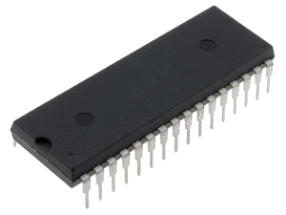
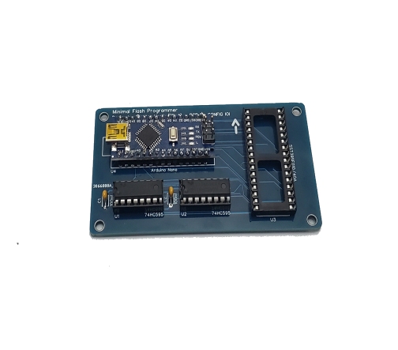
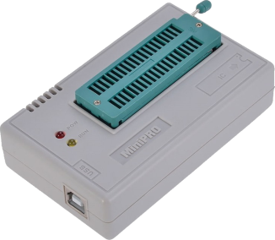
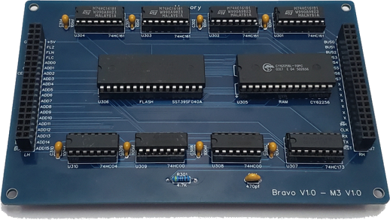
Method 1
Flash Memories in Bravo Project
1 x SST39SF040
2 x SST39SF010
512 KB
Memory Module
128 KB
Control Logic
OS
Assembler
.
.
Micro Code
OR
Method 2
Files
Programs
File System
(Part of OS)

